Slide 1

EMPLOYEE RETENTION

Slide 2

Business Problem Employee Retention Program – Recruit and Retain Talent Team: I want to Incentivize Employees to Stay in the company. Who should I be incentivizing?
The HR department from ABC IT company that Recruit and Retain jobs ensures that its employees don’t quit their jobs.
The HR team has limited funds, they cannot compensate every employee and is concerned about who they should incentivize to increase retention.

Slide 3
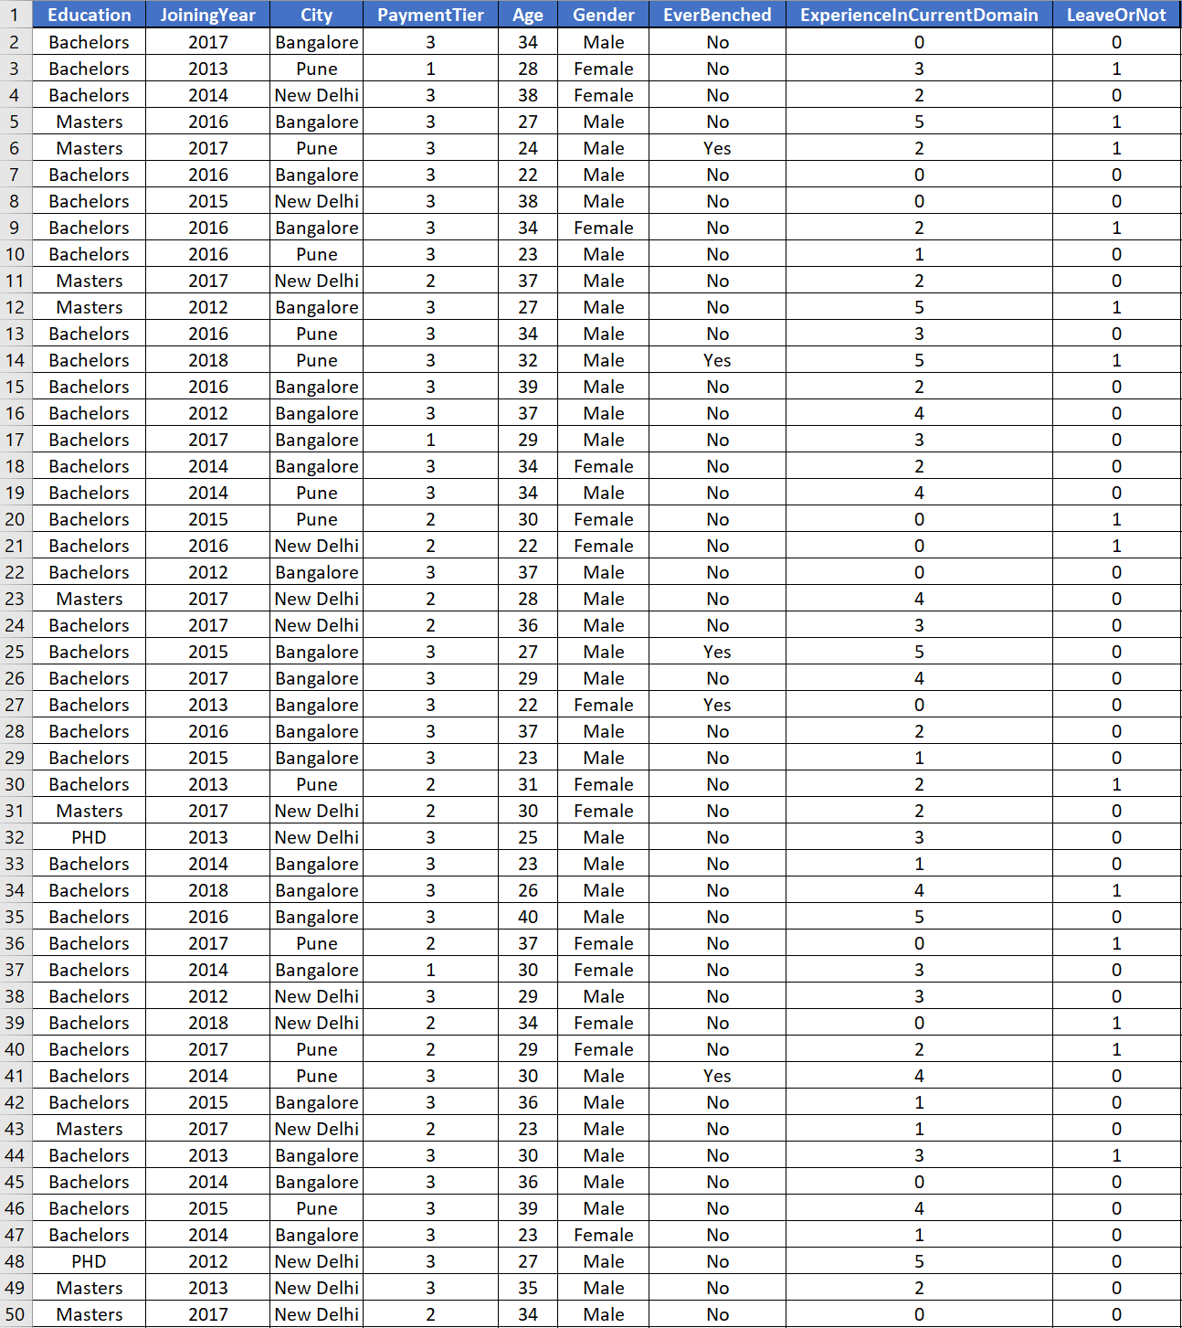
Dataset
Variable Description:
Employee Education: Bachelors, Masters and PHD.
Joining Year
City
Payment Tier: 1- Highest, 2 – Medium, 3 – Lowest.
Age
Gender – Male/Female
Ever Benched – Yes/No
Experience in Current Domain (in years)
Leave or Not (Yes - 1/No - 0)

Slide 4
Dataset Summary
Binary:
Leave or Not: Yes – 34.34%, No - 65.66%
Ever Benched: Yes – 10.28%, No - 89.72%
Categorical:
Education:
Bachelors: 77.40%
Masters: 18.76%
PHD: 3.84%
City:
Bangalore: 47.88%
Delhi: 24.86%
Pune: 27.25%
Payment Tier:
1 – 5.2%
2 – 19.72%
3 – 75.04%
Experience in Current Domain:
0 – 7.65%
1 – 11.99%
2 – 23.36%
3 – 16.89%
4 – 20%
5 – 19.75%
6 – 0.17%
7 – 0.19%
Gender:
Male: 59.70%
Female: 40.29%

Slide 5
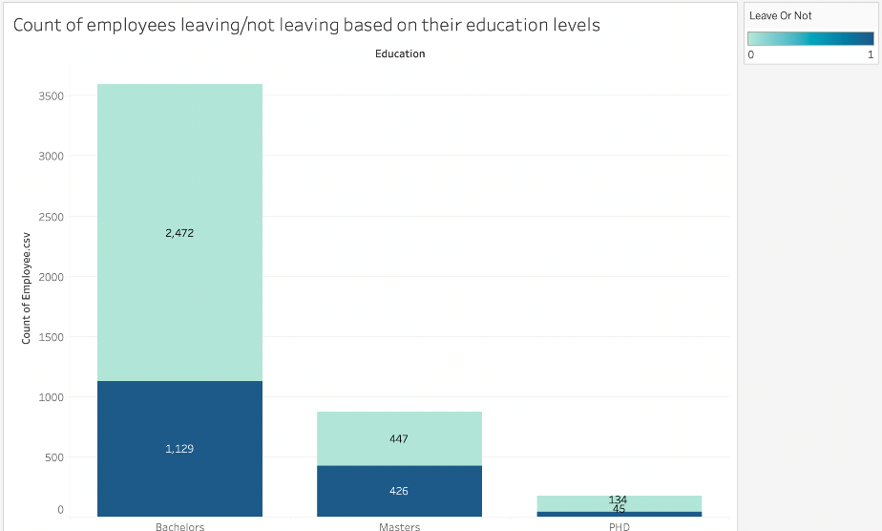
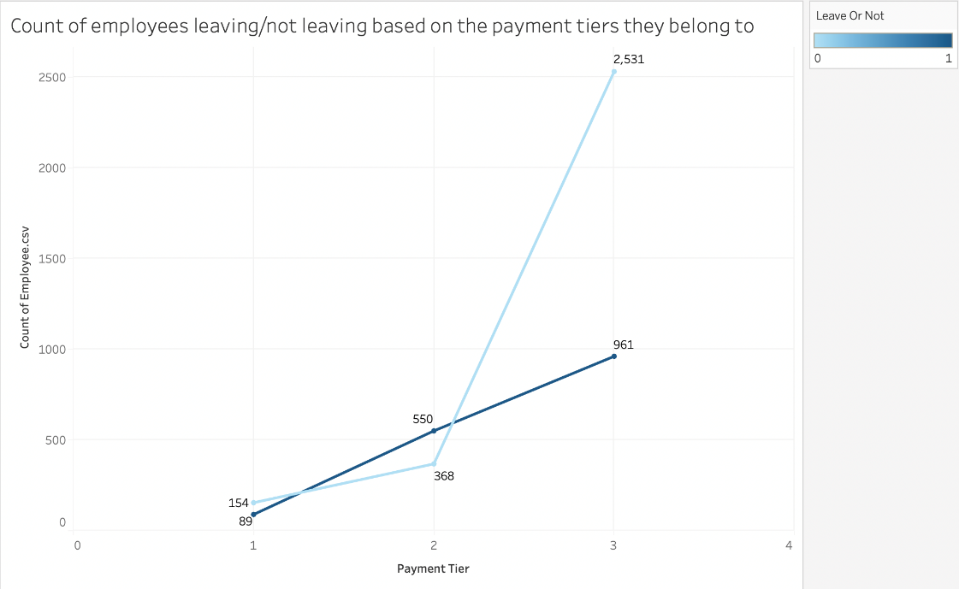
Data Visualization:
For Data exploration we used Tableau to understand the data.
For Data Visualization we used Bar charts, Line charts and Pie charts.
The graph shows that nearly half of Masters' degree holding employees are likely to leave the company.
The graph represents that employees of payment Tier 2 are likely to leave the company.
Notes:
Consider talking about:
Psychology
Cognitive sciences
Computer science
Logic
Engineering
Military science

Slide 6
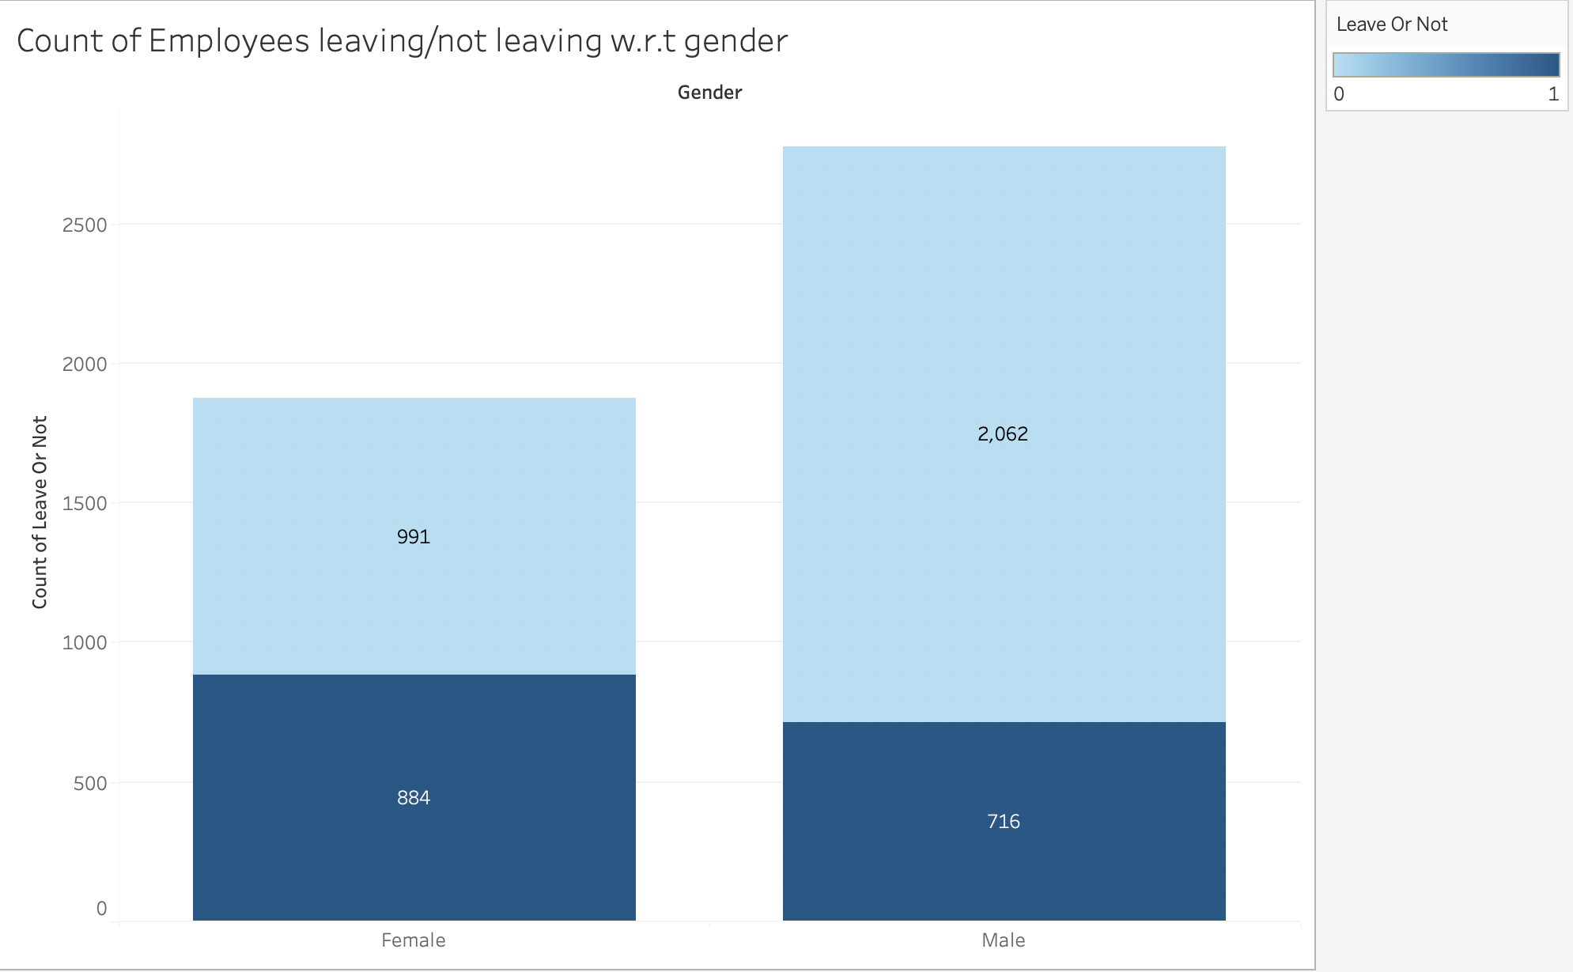
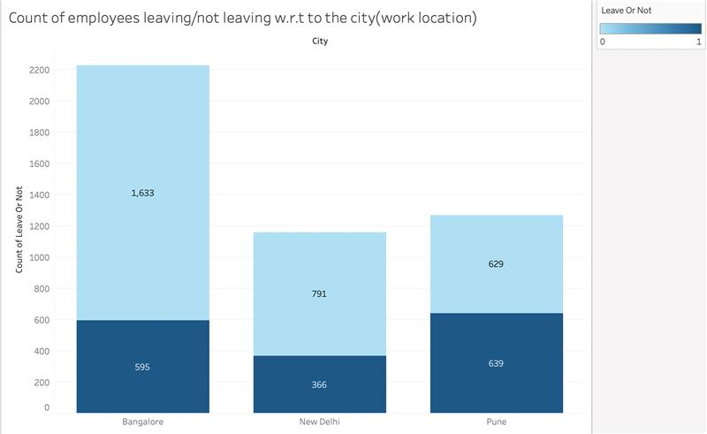
Data Visualization:
The below graph represents that high number of female employees are likely to leave the company.
A little more than half of the employees from Pune location are leaving the company and its relatively high compared to Bangalore and New Delhi locations.
Notes:
Consider talking about:
Psychology
Cognitive sciences
Computer science
Logic
Engineering
Military science

Slide 7
Correlation matrix
From the correlation matrix, we can see that Gender, Payment tier, Joining Year and education are some of the significant variables.
 | Education | JoiningYear | City | PaymentTier | Age | Gender | EverBenched | ExperienceInCurrentDomain | LeaveOr0t
Education | 1
JoiningYear | 0.14267035 | 1
City | 0.39088958 | 0.13826403 | 1
PaymentTier | -0.140741 | -0.0960782 | -0.2326826 | 1
Age | -0.0106111 | 0.01316529 | -0.0413643 | 0.0076309 | 1
Gender | 0.01088881 | 0.01221254 | 0.20944212 | -0.2351186 | 0.00386558 | 1
EverBenched | -0.0522486 | 0.04935304 | -0.0266994 | 0.01920723 | -0.0161355 | -0.0196529 | 1
ExperienceInCurrentDomain | -0.0044626 | -0.0365246 | -0.0110926 | 0.01831432 | -0.1346429 | -0.0087454 | 0.00140761 | 1
LeaveOr0t | 0.08049708 | 0.18170548 | 0.07673039 | -0.1976378 | -0.0511259 | 0.22070051 | 0.07843772 | -0.0305041 | 1

Slide 8
How do you use the data to answer the business question? What are the data Mining Models Used?
The goal is to find out the probability of employees who are leaving, Not Leaving and Uncertain.
We take the data and divide it into two sections: 80%(Train) and 20%(Test).
Using 80% of the data to train the model and 20% to test the model and make predictions.
Calculating the probability of leaving, which are classified as follows:
0 to 0.3 – Indicates the probability of employees not leaving the company. There is no need to incentivize because they won’t leave the company.
0.3 to 0.65 – Indicates the probability of employees that are uncertain (Undecided) whether to leave or stay with the company. These employees need to be incentivized to obtain maximum retention.
0.65 to 1.0 – Indicates the probability of employees who are leaving the company, there is not need to incentivize because they will leave the company even if they are incentivized.

Slide 9
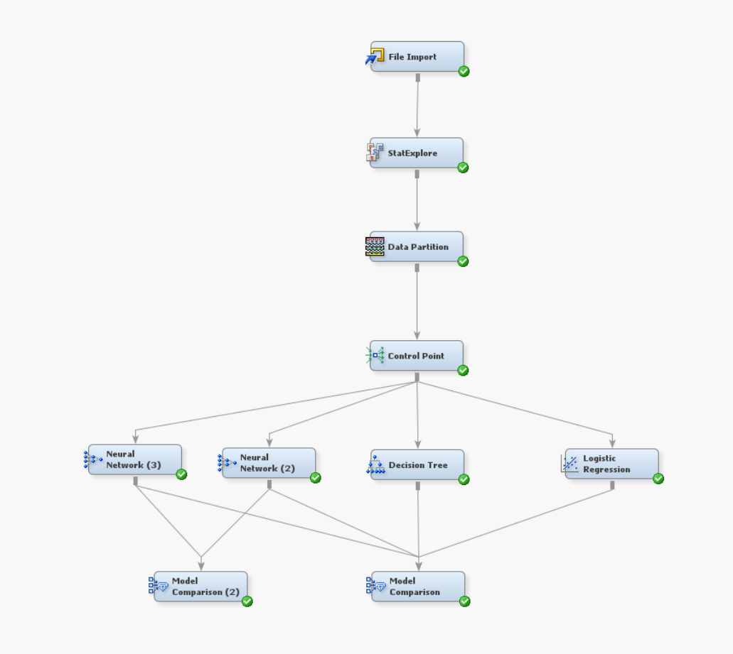
SAS Enterprise Miner Flow Diagram
To train and test the data, we used multiple data mining models like Neural Networks, Decision trees and Logistic Regression.

Slide 10
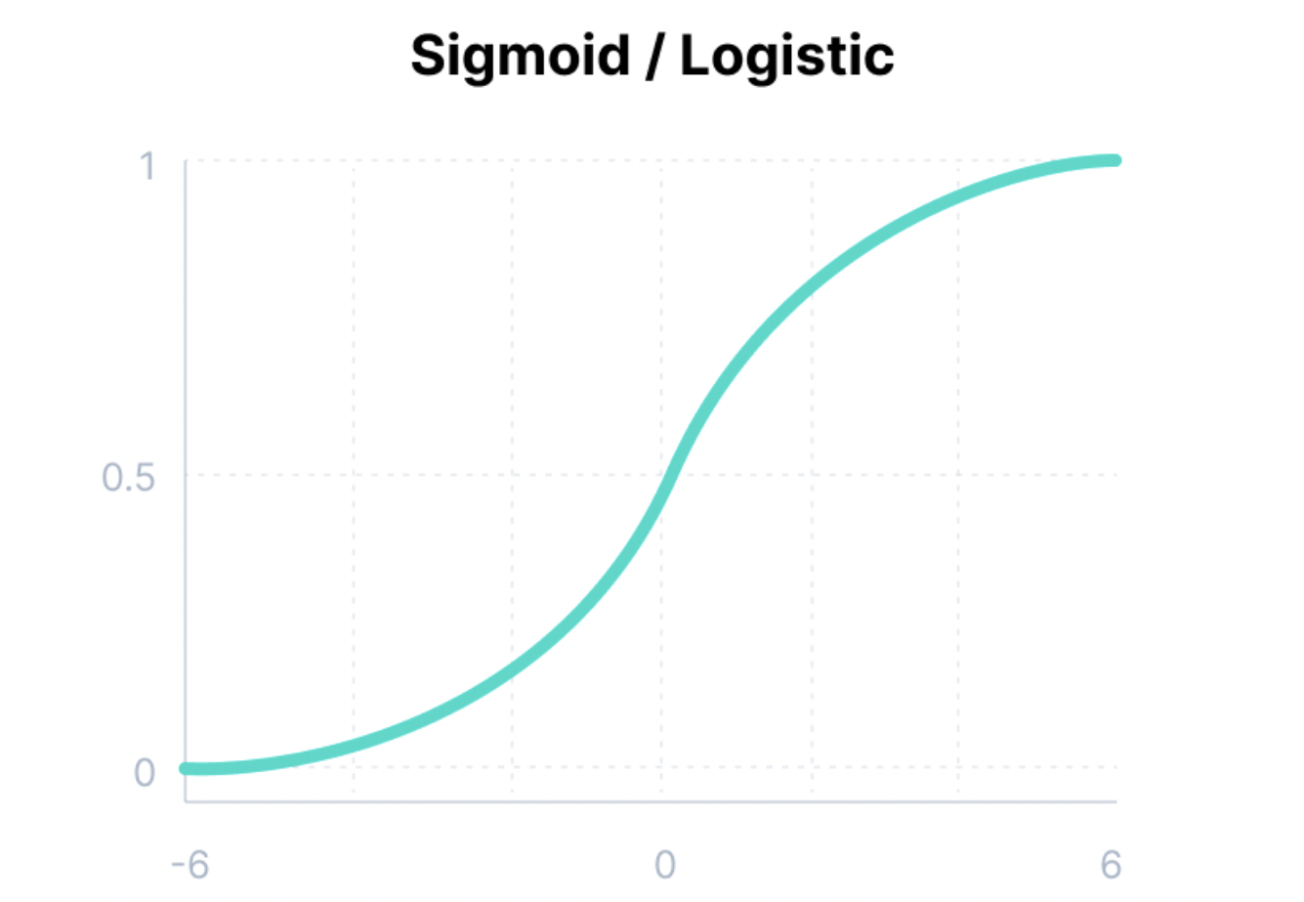
Neural Network
A neural network is series of algorithms that endeavours to recognize underlying relationships in a set of data through a process that mimics the way the human brain operates
Activation function helps the neural to use important information while suppressing irrelevant data points.
Sigmoid/Logistic Activation Function
This function takes any real value as input and outputs values in the range of 0 to 1.
The larger the input (more positive), the closer the output value will be to 1.0, whereas the smaller the input (more negative), the closer the output will be to 0.0, as shown below.

Slide 11
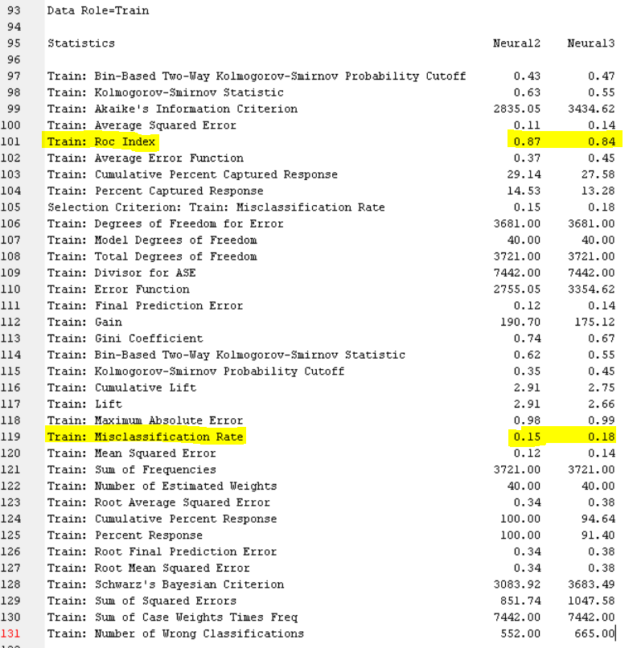
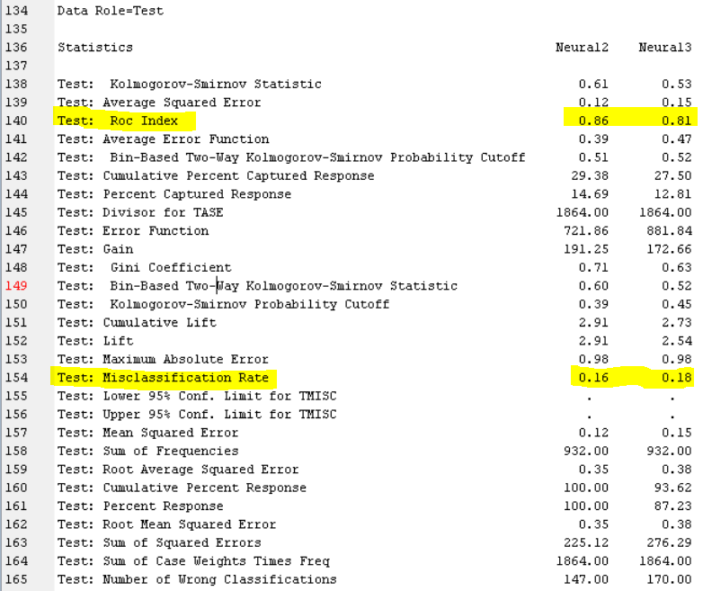
Neural Network Results:
Here are the ROC Index and Misclassification rate for both the models of neural networks. The left side results are for train data and right side one is for test data.

Slide 12
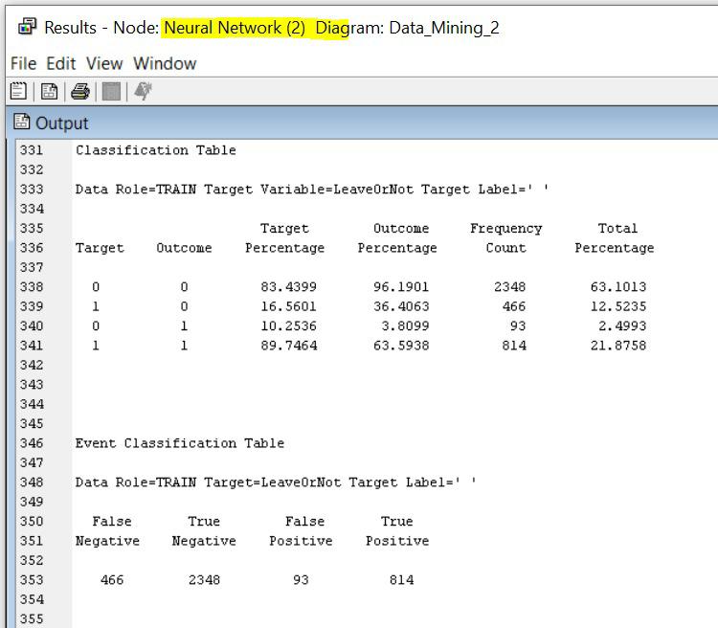
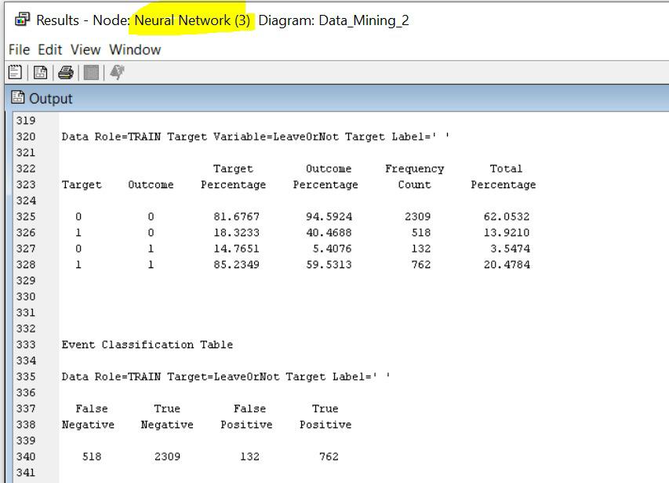
Classification Table
Neural Network: Multilayer Perceptron
Neural Network: Backward error propagation
Accuracy = ((TP+TN)/(TP+FN+FP+TN)) X 100
= 84.97%
Precision = ((TP)/(TP+FP)) X 100
= 89.74%
Recall = ((TP)/(TP+FN)) X 100
= 63.59%
F1 score = ((2TP)/(2TP+FP+FN)) X 100
=74.43%
Accuracy = ((TP+TN)/(TP+FN+FP+TN)) X 100
= 82.53%
Precision = ((TP)/(TP+FP)) X 100
= 85.23%
Recall = ((TP)/(TP+FN)) X 100
= 59.53%
F1 score = ((2TP)/(2TP+FP+FN)) X 100
= 70.10%

Slide 13
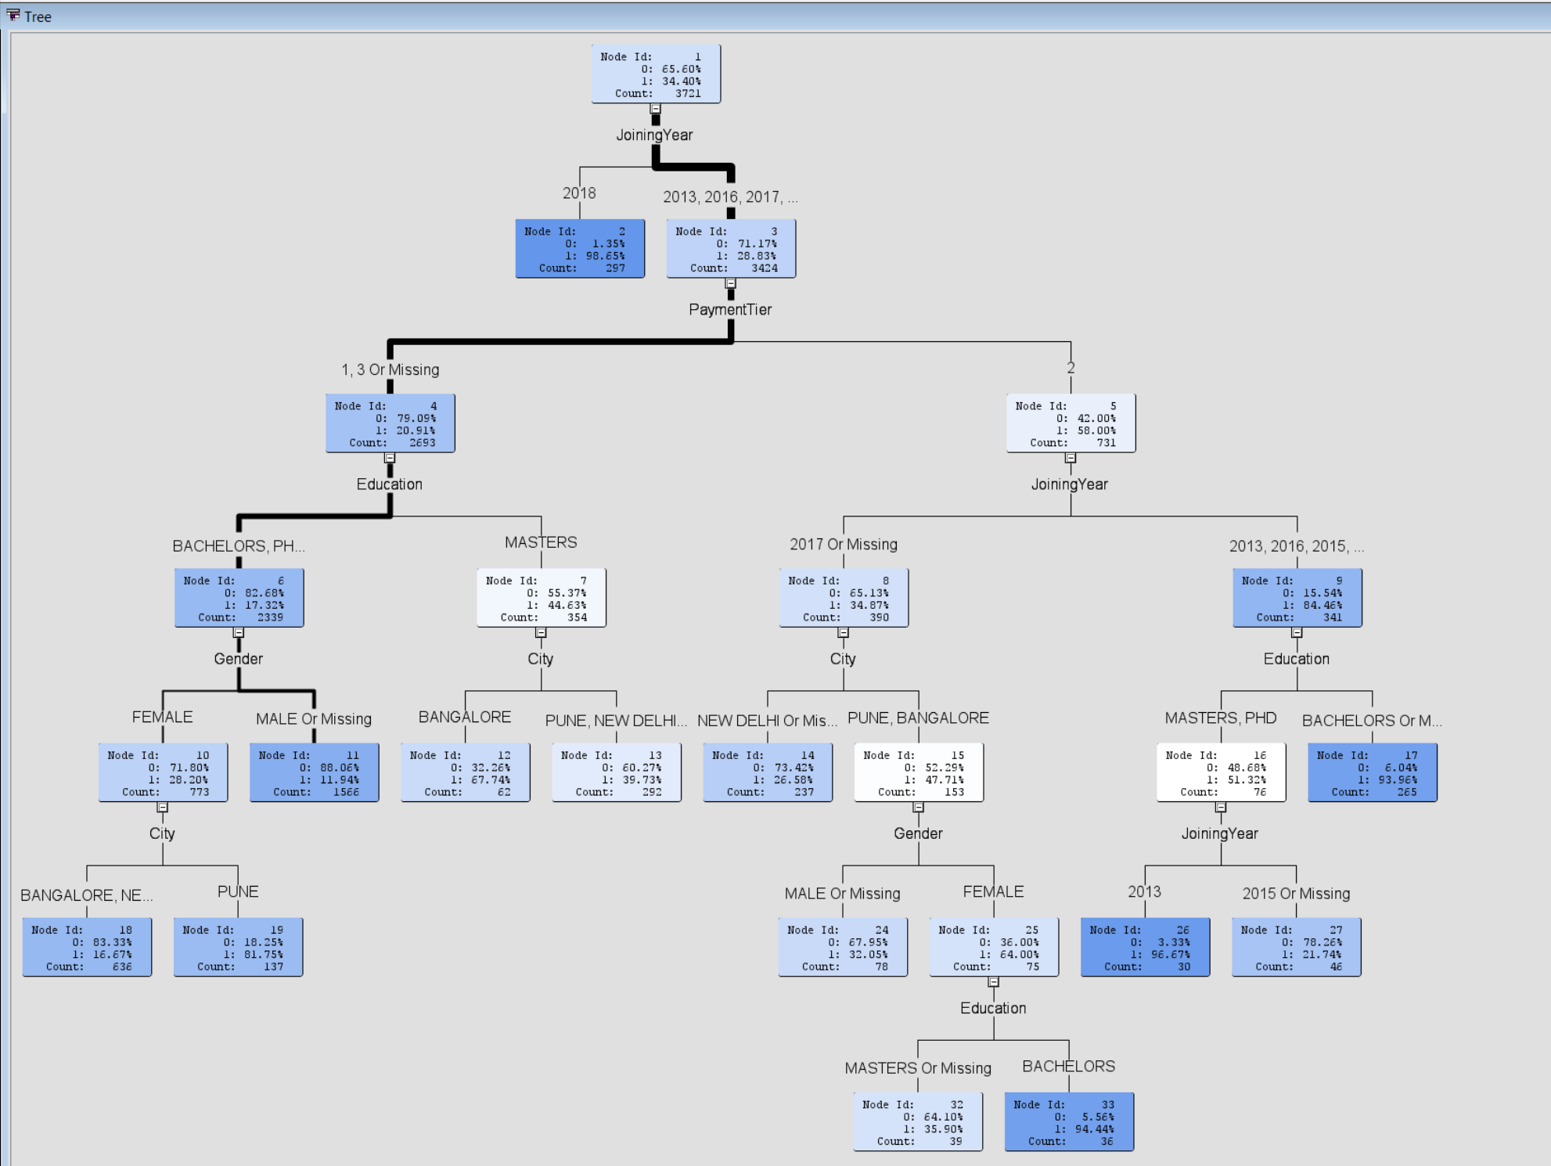
Decision Tree
Decision Tree is used to classify or predict an outcome based on a set of predictors.
According to our requirement we have set our goal as to classify whether the employee decision is to “leave” or “not leave” or “Uncertain”.
Example:
Employees whose joining year is 2018 are likely to leave the organization.
Rule might be “IF (Joining Year is 2012 - 2017) AND (Payment Tier is 1 or 3) AND (Education is Masters) AND (Working city is Bangalore) THEN Class = 1 (Leave the organization).

Slide 14
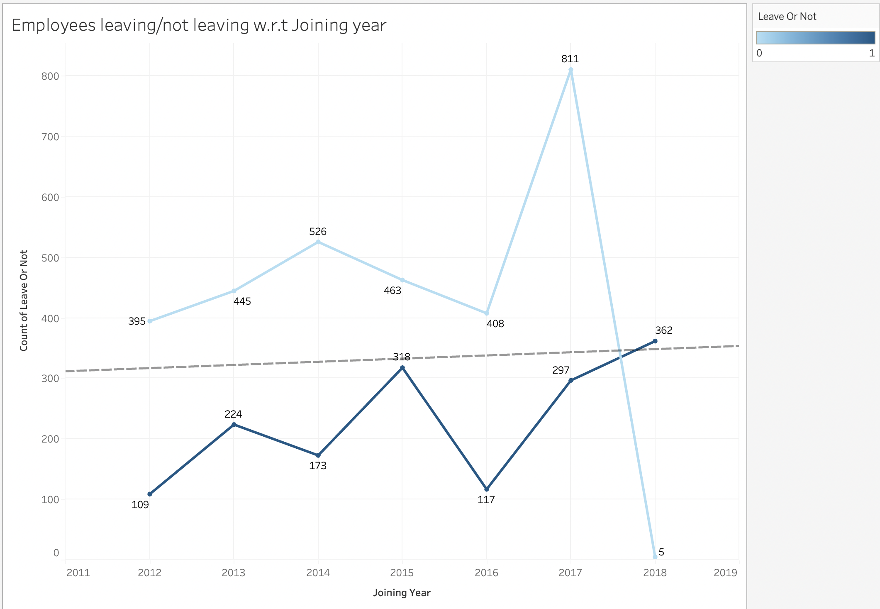
Employee Decision w.r.t Joining Year
As observed, employees whose joining year is 2018 are likely to leave the company. Here is the graph supporting the statement.
Total number of employees whose joining year is 2018 are 367 out of them 362 employees are leaving the organization and only 5 are not.

Slide 15
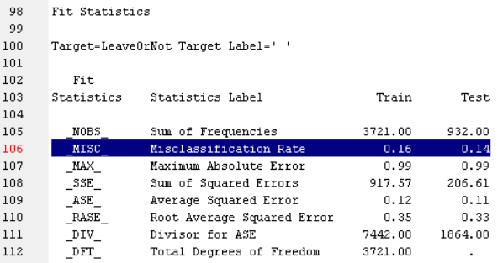
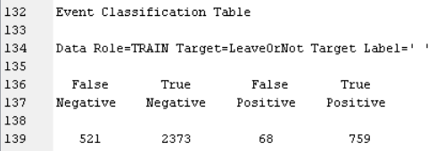
Decision Tree Results
Accuracy, Precision and Recall are most widely used metric for model comparison.
Accuracy = ((TP+TN)/(TP+FN+FP+TN)) X 100
= 84.17%
Precision = ((TP)/(TP+FP)) X 100
= 91.77%
Recall = ((TP)/(TP+FN)) X 100
= 59.29%
F1 score = ((2TP)/(2TP+FP+FN)) X 100
=72.04%

Slide 16
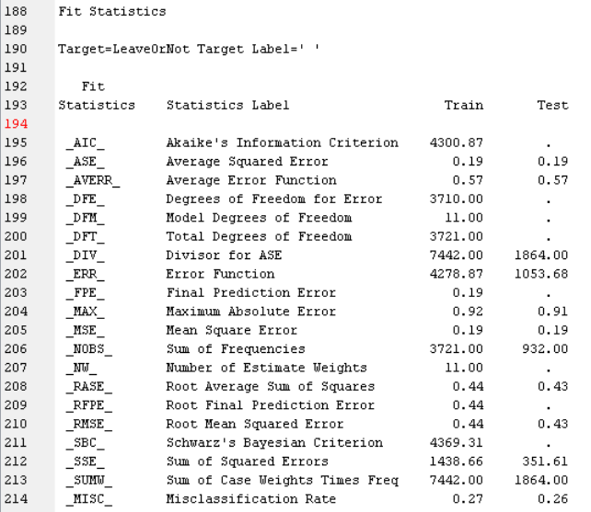
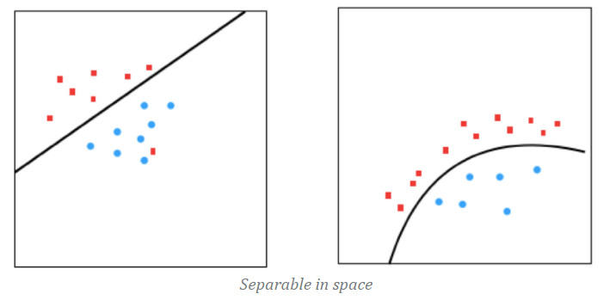
Logistic Regression
Average Misclassification Rate
Attempts | Train | Test
1 | 0.27 | 0.29
2 | 0.27 | 0.28
3 | 0.27 | 0.29
4 | 0.27 | 0.28
5 | 0.28 | 0.25
6 | 0.27 | 0.28
7 | 0.28 | 0.25
8 | 0.27 | 0.28
9 | 0.26 | 0.29
10 | 0.27 | 0.26
Avg | 0.271 | 0.275
Logistic Regression assumes that the data is linearly (or curvy linearly) separable in space on to exactly two planes.

Slide 17
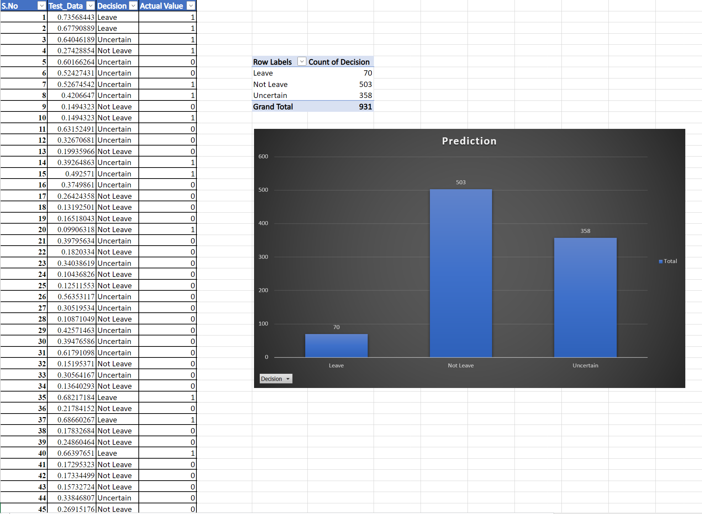
Logistic Regression using R
The following probabilities are predictions on 20% of test data(931 observations).
Prob | Decision | Count
0 to 0.3 | Not Leave | 503
0.3 to 0.65 | Uncertain | 358
0.65 to 1.0 | Leave | 70
Total |  | 931

Slide 18
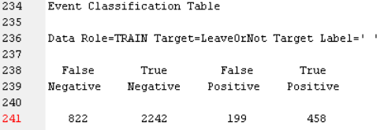
Logistic Regression Results
Train Data
Test Data
False Negative | True Negative | False Positive | True Positive
204 | 594 | 40 | 93
Accuracy = ((TP+TN)/(TP+FN+FP+TN)) X 100
= 72.56%
Precision = ((TP)/(TP+FP)) X 100
= 69.71%
Recall = ((TP)/(TP+FN)) X 100
= 35.78%
F1 score = ((2TP)/(2TP+FP+FN)) X 100
=47.29%
Accuracy = ((TP+TN)/(TP+FN+FP+TN)) X 100
= 73.79%
Precision = ((TP)/(TP+FP)) X 100
= 69.92%
Recall = ((TP)/(TP+FN)) X 100
= 31.31%
F1 score = ((2TP)/(2TP+FP+FN)) X 100
=43.25%

Slide 19
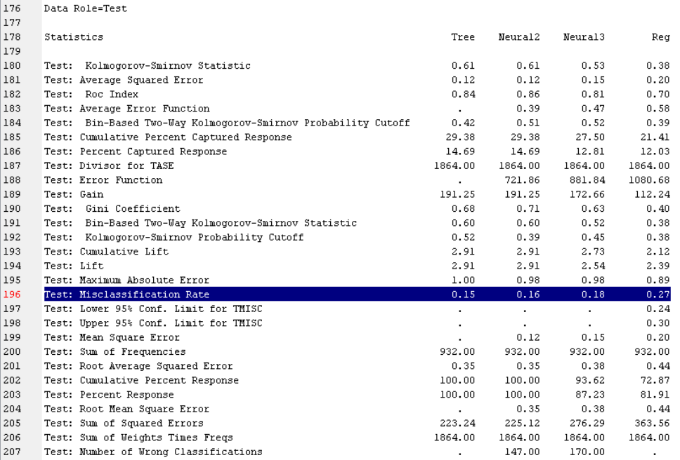
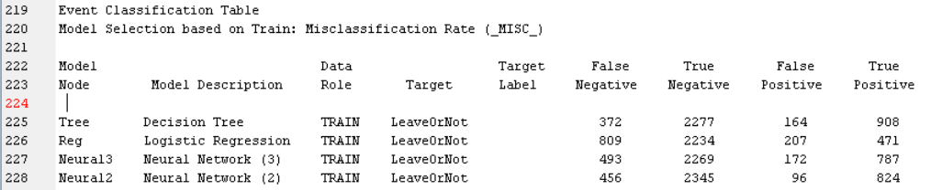
Model Comparison
Decision Tree is the best model to predict the employees decision whether to stay or leave the company.

Slide 20
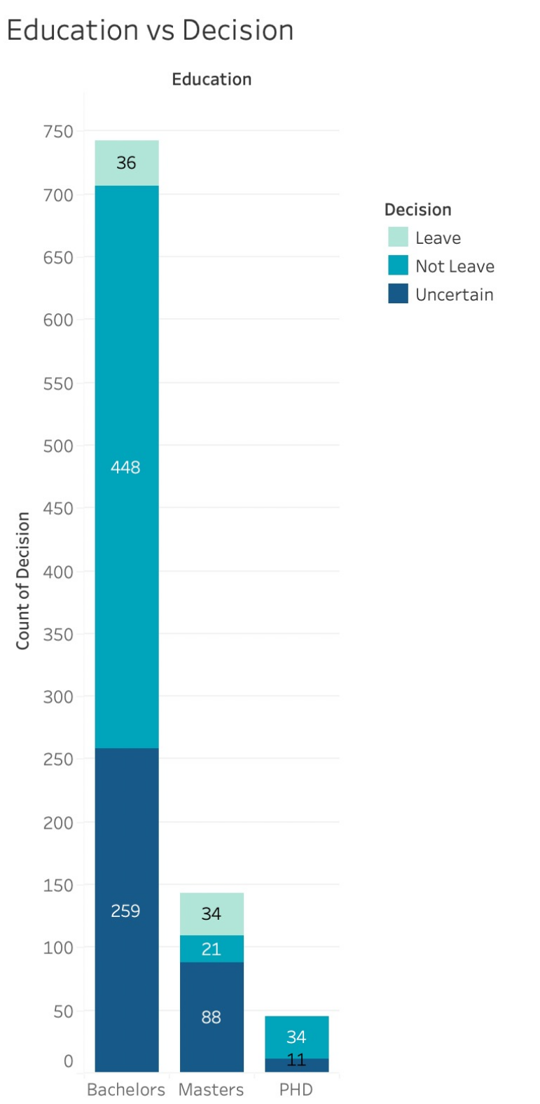
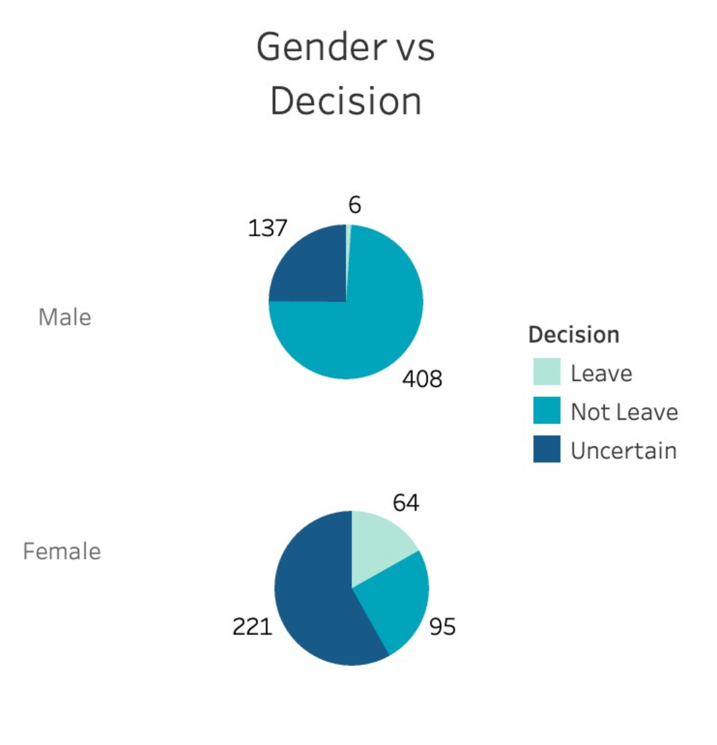
Data Prediction Insights for HR Department:
The Pie Chart depicts that the Female employees are more likely to leave the company compared to Male employees.
The Bar graph shows that the employees with master's degree are more likely to leave company compared to others.

Slide 21

Thank You

